Slide 1

Devoir 1
Vérification et Validation en Modélisation Numérique
Vérification de code
David Vidal
S. Paquette-Greenbaum, R. Zachariah, & K. A. N. Lippert
February 12nd 2024
https://github.com/karolali22/MEC8211_PROJECT

Slide 2
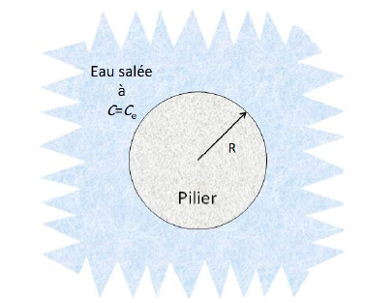

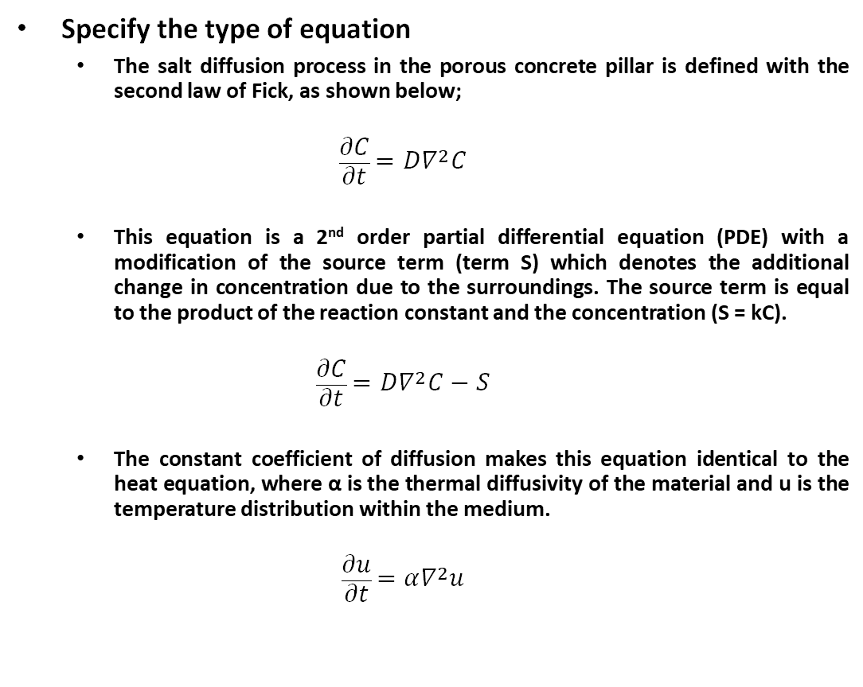
A. SIMPLIFY & ESTABLISH THE PROBLEM
Specify the type of equation
The salt diffusion process in the porous concrete pillar is defined with the second law of Fick, as shown below;
$$\frac{∂C}{∂t}=D∇^{2}C$$
This equation is a 2nd order partial differential equation (PDE) with a modification of the source term (term S) which denotes the additional change in concentration due to the surroundings. The source term is equal to the product of the reaction constant and the concentration (S = kC).
$$\frac{∂C}{∂t}=D∇^{2}C−S$$
The constant coefficient of diffusion makes this equation identical to the heat equation, where α is the thermal diffusivity of the material and u is the temperature distribution within the medium.
$$\frac{∂u}{∂t}=α∇^{2}u$$
Image 1: Cross-section of concrete pillar. Devoir 1. Moodle. https://moodle.polymtl.ca/pluginfile.php/1022883/mod_resource/content/5/Devoir1.pdf

Slide 3
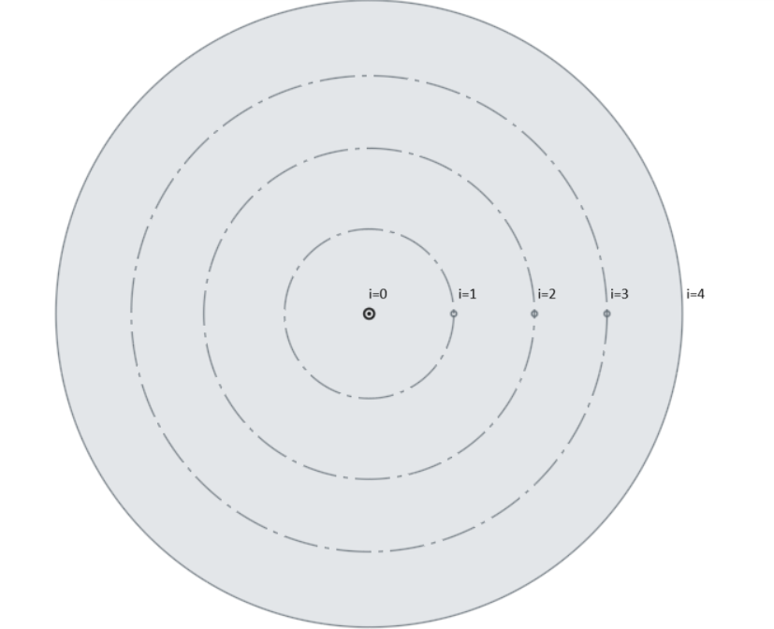
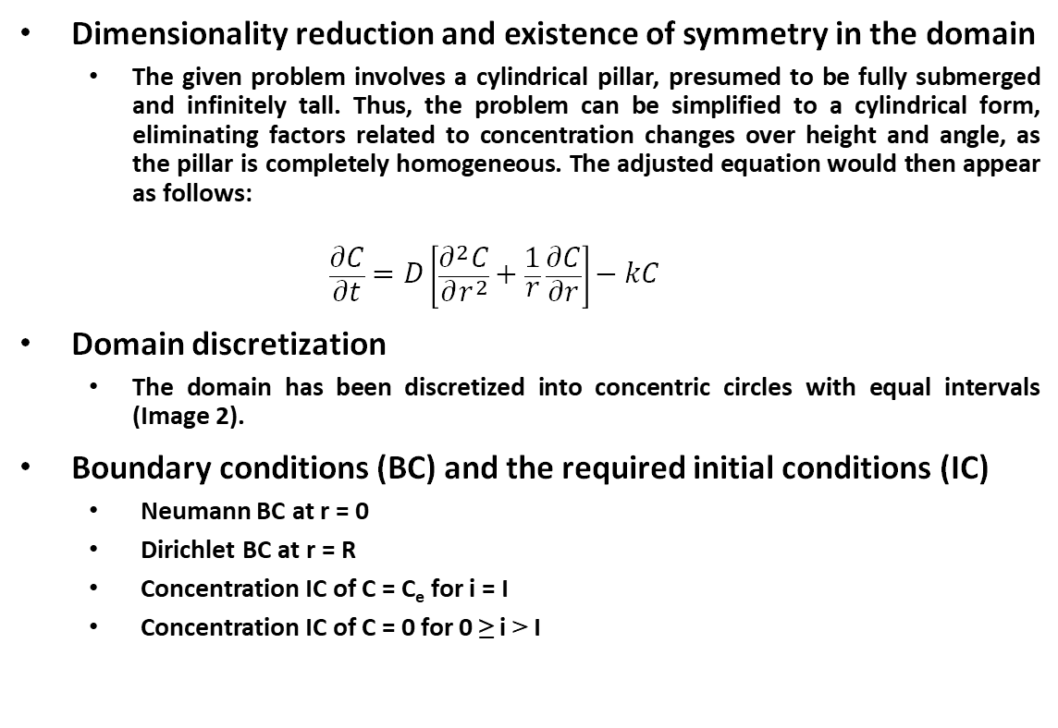
A. SIMPLIFY & ESTABLISH THE PROBLEM
Dimensionality reduction and existence of symmetry in the domain
The given problem involves a cylindrical pillar, presumed to be fully submerged and infinitely tall. Thus, the problem can be simplified to a cylindrical form, eliminating factors related to concentration changes over height and angle, as the pillar is completely homogeneous. The adjusted equation would then appear as follows:
$$\frac{∂C}{∂t}=D\left[\frac{∂^{2}C}{∂r^{2}}+\frac{1}{r}\frac{∂C}{∂r}\right]−kC$$
Domain discretization
The domain has been discretized into concentric circles with equal intervals (Image 2).
Boundary conditions (BC) and the required initial conditions (IC)
Neumann BC at r = 0
Dirichlet BC at r = R
Concentration IC of C = C_{e} for i = I
Concentration IC of C = 0 for 0 ≥ i > I
Image 2: Cross-section of domain with discretization.

Slide 4
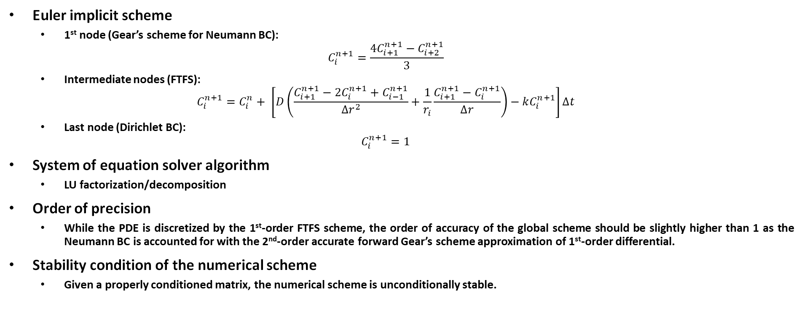
B. FINITE DIFFERENCE METHOD (1st-ORDER FTFS)
Euler implicit scheme
1st node (Gear’s scheme for Neumann BC):
$$C_{i}^{n+1}=\frac{4C_{i+1}^{n+1}−C_{i+2}^{n+1}}{3}$$
Intermediate nodes (FTFS):
$$C_{i}^{n+1}=C_{i}^{n}+ \left[D\left(\frac{C_{i+1}^{n+1}−{2C}_{i}^{n+1}+C_{i−1}^{n+1}}{∆r^{2}}+\frac{1}{r_{i}}\frac{C_{i+1}^{n+1}−C_{i}^{n+1}}{∆r}\right)−kC_{i}^{n+1}\right]∆t$$
Last node (Dirichlet BC):
$$C_{i}^{n+1}=1$$
System of equation solver algorithm
LU factorization/decomposition
Order of precision
While the PDE is discretized by the 1st-order FTFS scheme, the order of accuracy of the global scheme should be slightly higher than 1 as the Neumann BC is accounted for with the 2nd-order accurate forward Gear’s scheme approximation of 1st-order differential.
Stability condition of the numerical scheme
Given a properly conditioned matrix, the numerical scheme is unconditionally stable.

Slide 5
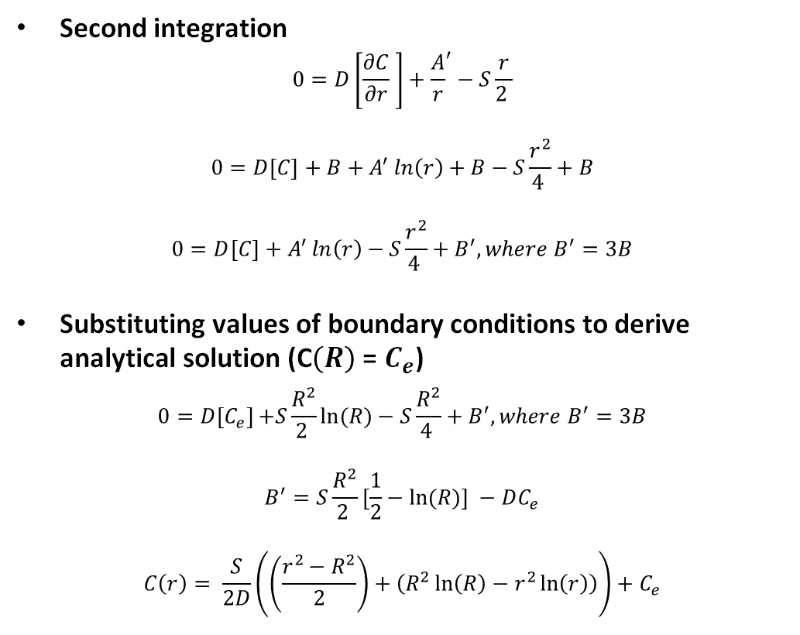

C. ANALYTICAL SOLUTION
Setting Problem statement
$$\frac{∂C}{∂t}=D\left[\frac{∂^{2}C}{∂r^{2}}+\frac{1}{r}\frac{∂C}{∂r}\right]−kC$$
$$\frac{∂C}{∂t}=0 \left(due to steady state\right)$$
$$S=kC$$
$$0=D\left[r\frac{∂^{2}C}{∂r^{2}}+\frac{∂C}{∂r}\right]−Sr$$
First integration
$$0=D\left[r\frac{∂C}{∂r} −C+A\right]+D\left[C+A\right]−S\frac{r^{2}}{2 }+A$$
$$0=D\left[r\frac{∂C}{∂r} \right]+A^{′}−S\frac{r^{2}}{2 },where A^{′}=A\left(2D+1\right)$$
$$at \frac{∂C}{∂r}=0 and r=0 ( flux rate is 0) A′=S\frac{r^{2}}{2 }$$
Second integration
$$0=D\left[\frac{∂C}{∂r} \right]+{\frac{A}{r}}^{′}−S\frac{r}{2 }$$
$$0=D\left[C\right]+B+A^{′}\ln\left(r\right)+B−S\frac{r^{2}}{4 }+B$$
$$0=D\left[C\right]+A^{′}\ln\left(r\right)−S\frac{r^{2}}{4 }+B^{′}, where B^{′}=3B$$
$\text{Substituting} \text{values} \text{of} \text{boundary} \text{conditions} \text{to} \text{derive} \text{analytical} \text{solution}\text{ (}\text{C}\left(R\right) \text{= }C_{e}\text{)}$
$$0=D\left[C_{e}\right]+S\frac{R^{2}}{2 }ln{(R)}−S\frac{R^{2}}{4 }+B^{′}, where B^{′}=3B$$
$$B^{′}=S\frac{R^{2}}{2 }[\frac{1}{2}−ln{(R)] −DC_{e}}$$
$$C\left(r\right)= \frac{S}{2D}\left(\left(\frac{r^{2}−R^{2}}{2}\right)+\left(R^{2}\ln\left(R\right)−r^{2}\ln\left(r\right)\right)\right)+C_{e}$$

Slide 6
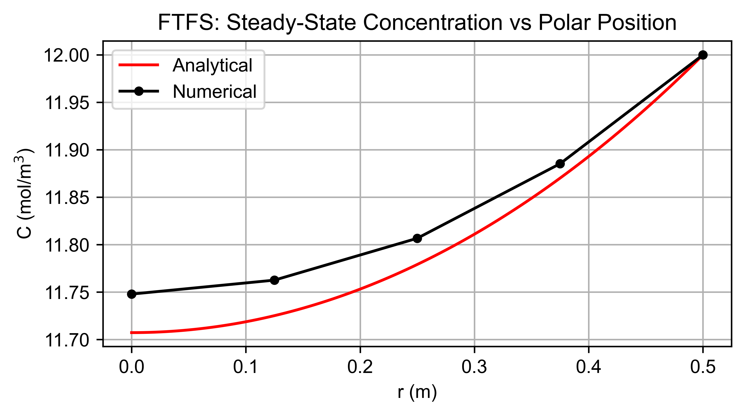
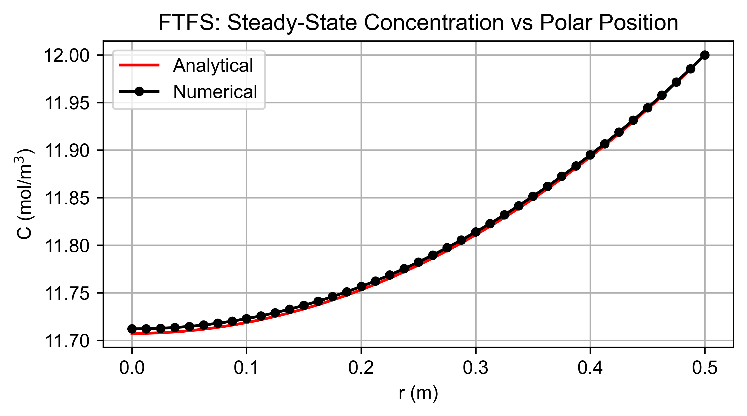
D. NUMERICAL SOLUTION (1st-ORDER FTFS)
Parameters
Physical parameters: (values were chosen to ensure matrix was well conditioned)
D_{eff} = 10⁻² m²/s, k = 4×10⁻³ s⁻¹, Ce = 12 mol/m³, R = 0.5 m
Discretization parameters:
∆t = 200 s, ∆r = 0.125 m (Figure 1) & ∆r = 0.0125 m (Figure 2)
Simulation parameters:
convergence tolerance = 10⁻¹⁶ mol/m³
Figure 1
Figure 2

Slide 7
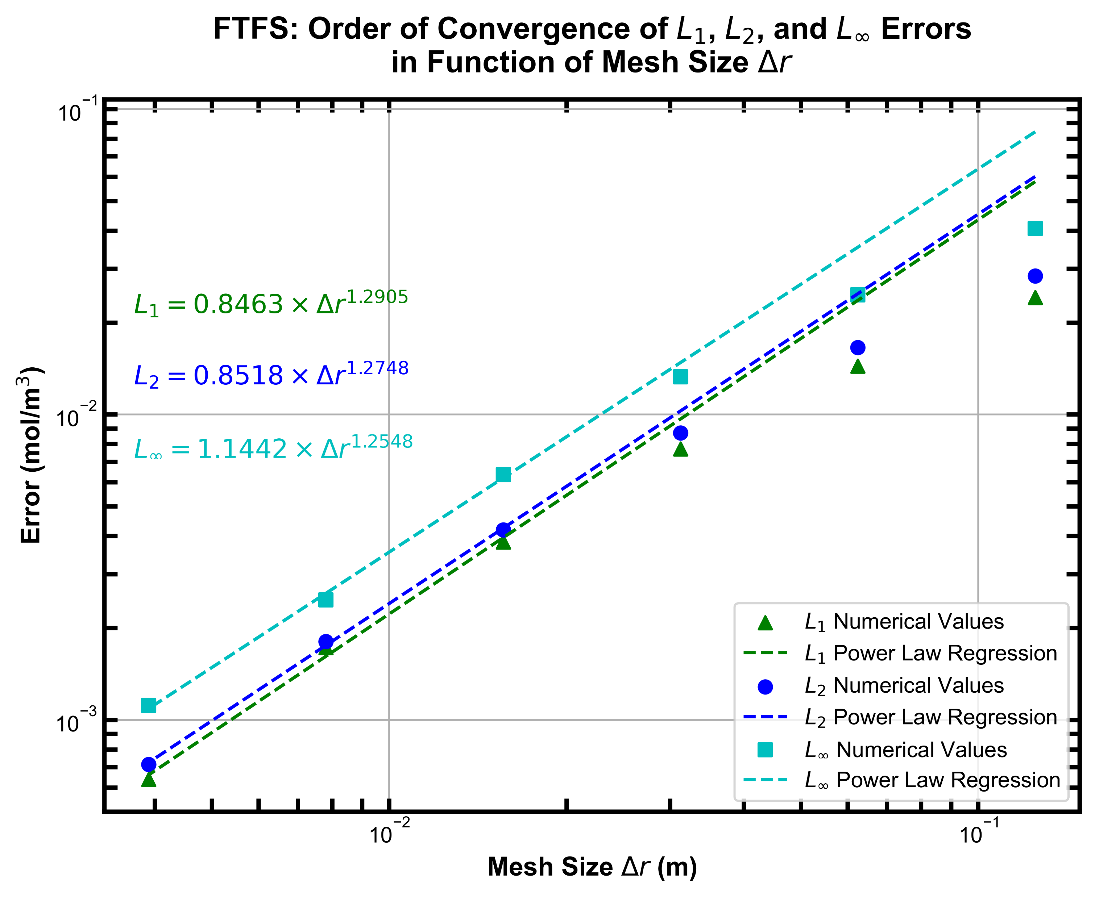
E. FINITE DIFFERENCE METHOD VERIFICATION (1st-ORDER FTFS)
Parameters
Physical parameters (chosen so that matrix is well conditioned):
D_{eff} = 10⁻² m²/s, k = 4×10⁻³ s⁻¹, Ce = 12 mol/m³, R = 0.5 m.
Discretization parameters:
∆t = 200 s, 0.125 m < ∆r < 0.125/32 m.
Simulation parameters:
convergence tolerance = 10⁻¹⁶ mol/m³
Verification procedure
Error values for mesh sizes smaller than 0.125/32 m were not included in the figure as time discretization error was beginning to become apparent.
The calculated orders of convergence of L₁, L₂, and L∞ were greater than the 1st-order FTFS scheme’s theoretical order of accuracy (Figure 3). This was expected as the Neumann boundary condition was accounted for with the 2nd-order accurate forward Gear’s scheme approximation of 1st-order differential. The inclusion of a higher order approximation at the boundary will necessarily increase the overall order of convergence.
Figure 3

Slide 8
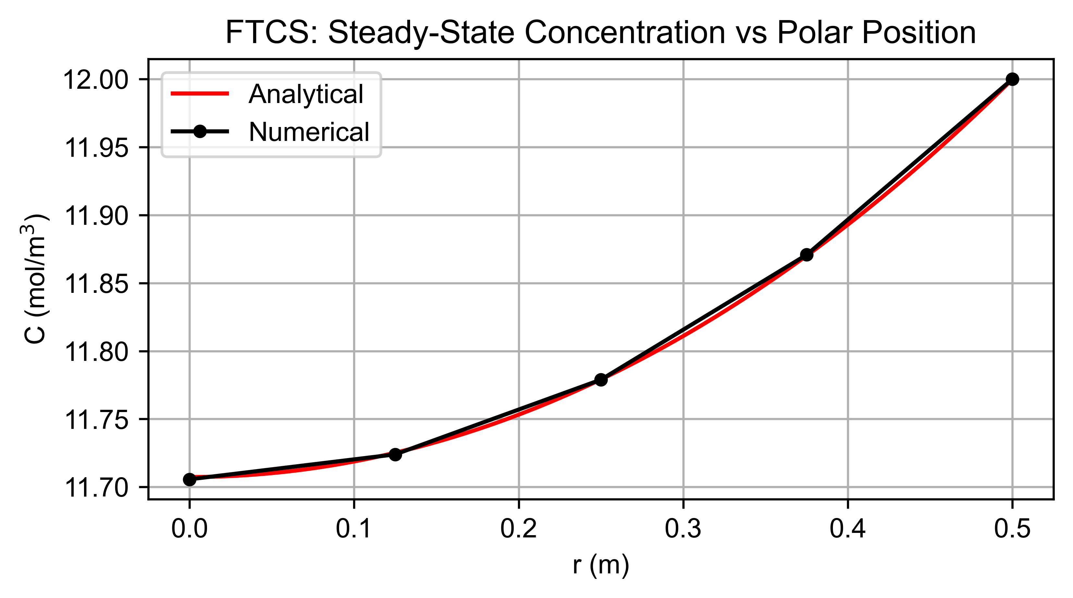
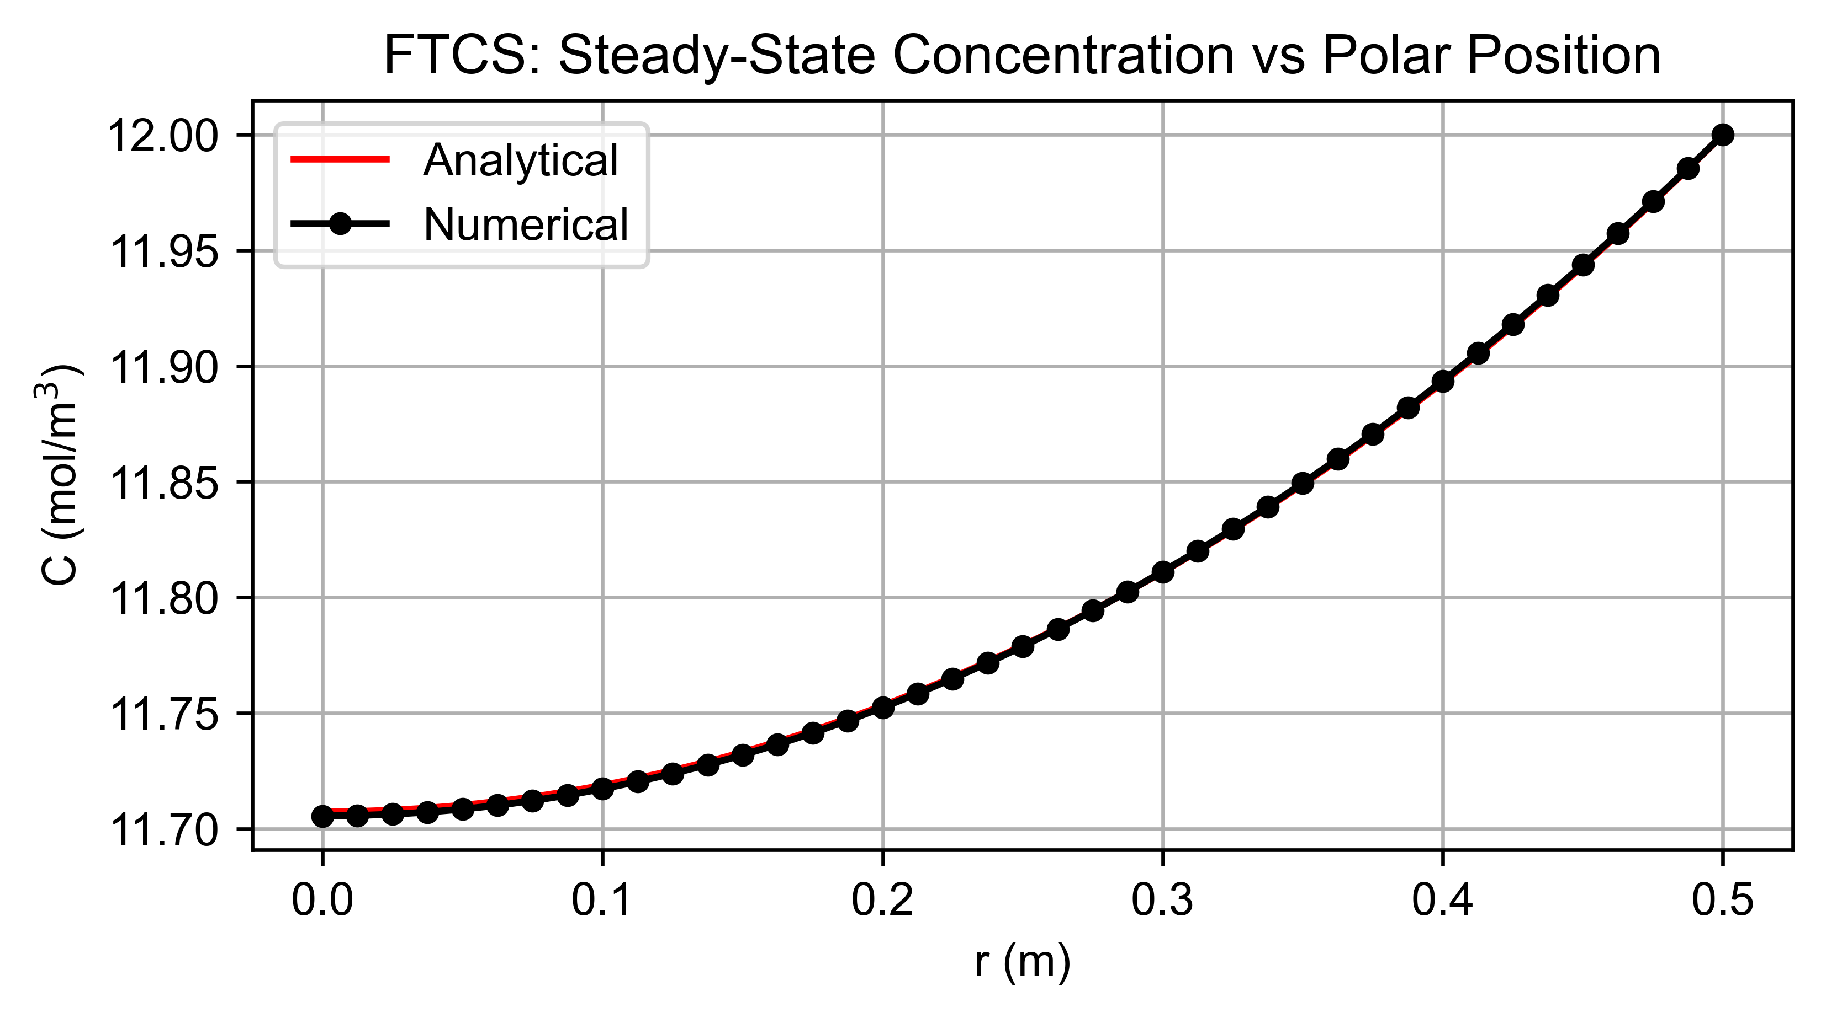
F. NUMERICAL SOLUTION (2nd-ORDER FTCS)
Parameters
Physical parameters: (values were chosen to ensure matrix was well conditioned)
D_{eff} = 10⁻² m²/s, k = 4×10⁻³ s⁻¹, Ce = 12 mol/m³, R = 0.5 m
Discretization parameters:
∆t = 200 s, ∆r = 0.125 m (Figure 4) & ∆r = 0.0125 m (Figure 5)
Simulation parameters:
convergence tolerance = 10⁻¹⁶ mol/m³
Figure 4
Figure 5

Slide 9
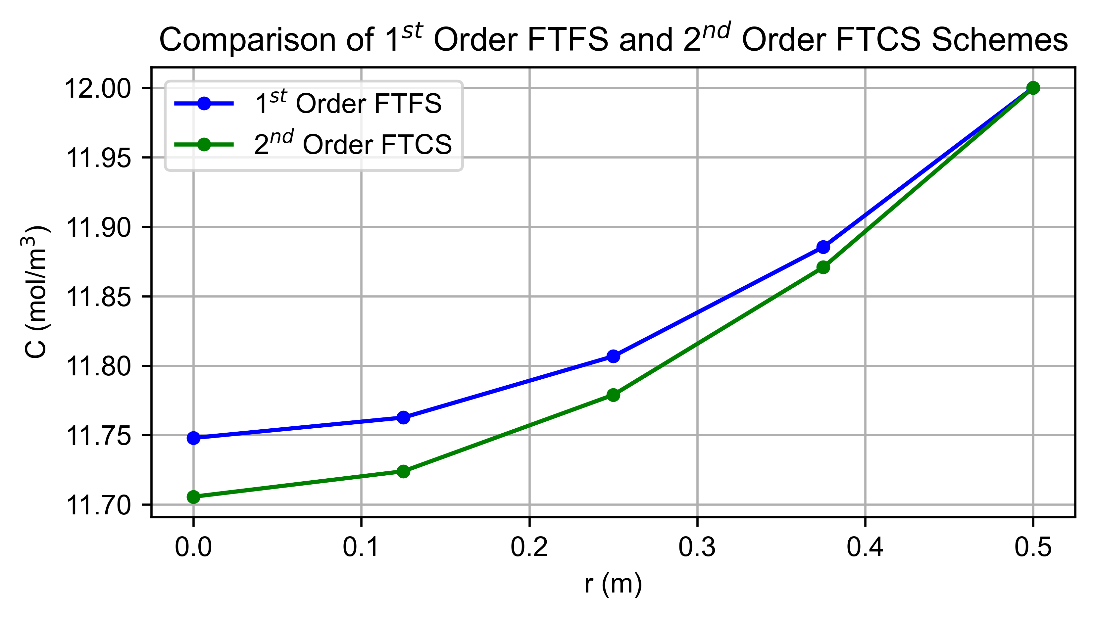
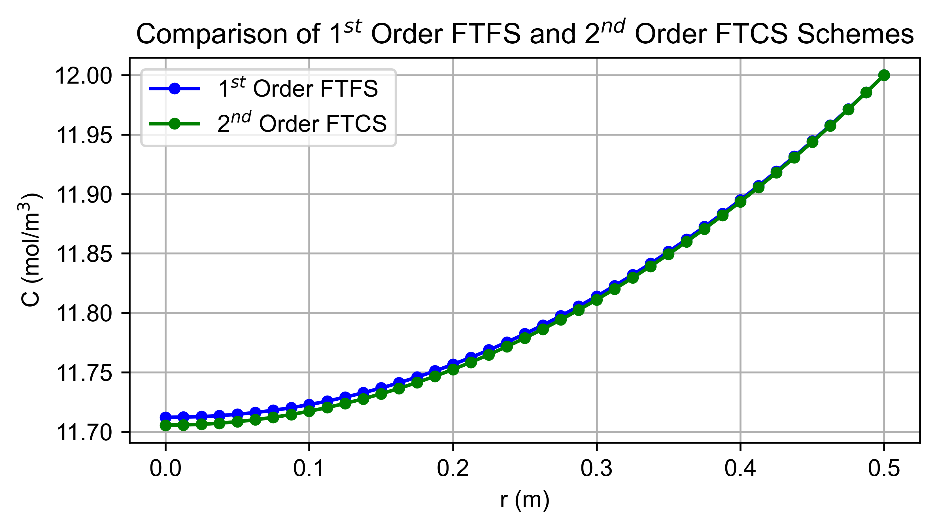
F. COMPARISON BETWEEN 1st-ORDER FTFS & 2nd-ORDER FTCS
Parameters
Physical parameters: (values were chosen to ensure matrix was well conditioned)
D_{eff} = 10⁻² m²/s, k = 4×10⁻³ s⁻¹, Ce = 12 mol/m³, R = 0.5 m
Discretization parameters:
∆t = 200 s, ∆r = 0.125 m (Figure 6) & ∆r = 0.0125 m (Figure 7)
Simulation parameters:
convergence tolerance = 10⁻¹⁶ mol/m³
Figure 6
Figure 7
Comparison
The 1st and 2nd order schemes do not converge to a solution in the same way as the mesh is refined. The 1st order scheme converges towards the analytical solution as the mesh is refined while the 2nd order scheme seems to have already converged at even an extremely coarse mesh. This is expected as the 2nd order FTCS scheme matches the approximated PDE’s order.

Slide 10
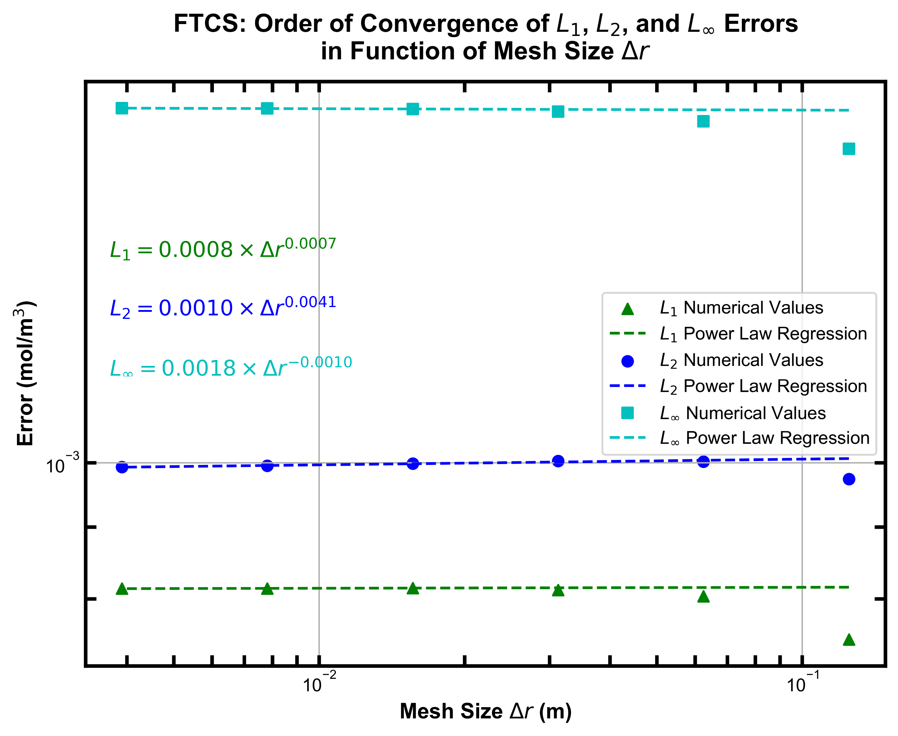
F. FINITE DIFFERENCE METHOD VERIFICATION (2nd-ORDER FTCS)
Parameters
Physical parameters (chosen so that matrix is well conditioned):
D_{eff} = 10⁻² m²/s, k = 4×10⁻³ s⁻¹, Ce = 12 mol/m³, R = 0.5 m.
Discretization parameters:
∆t = 200 s, 0.125 m < ∆r < 0.125/32 m.
Simulation parameters:
convergence tolerance = 10⁻¹⁶ mol/m³
Verification procedure
The calculated errors are constant across mesh size (Figure 8). This is expected as the order of the approximated PDE matches the numerical scheme’s overall order of accuracy. This is expected as in an instance where the numerical scheme matches the PDE’s order, the numerical and analytical solutions are expected to coincide fully.
Figure 8

Slide 11

THANK YOU!

